Slide 1

BANK DEPOSIT PREDICTION
Raju MLN | narasimha4789@gmail.com

Slide 2

Business Problem
The objective of the problem is to predict the amount that would be deposited in each branch in the year 2017.

Slide 3






Steps followed for model building…
1. Load data and inspection.
2. Exploratory Data Analysis.
3. Data preprocessing.
4. Preparing data for model building.
5. Applying multiple models for prediction.
6. Choosing best model for final prediction

Slide 4
Challenges deep dive…
Feature extraction from date_of_establishment column.
01
Extract age of bank
Feature extraction from location details.
02
Create clusters based on location details

Slide 5
1. Feature extraction from date_of_establishment column.
We can extract many features like date, month, year etc. from date_of_establishment column but the features which helps in obtaining business objective more deposits in bank is age of bank as of 2017.
Age of bank signifies it’s trustworthiness, therefore can grab more deposits.

Slide 6
2. Feature extraction from location details using clustering.
Technique 1:
Label Encoding of location details.
Apply K-Means clustering to find K clusters that represent data.
One Hot Encoding on clusters to make them numerical.
Technique 2:
Extract latitude and longitude from location details.
Apply K-Means clustering to find K clusters that represent data.
One Hot Encoding on clusters to make them numerical.

Slide 7
Exploratory Data Analysis

Slide 8
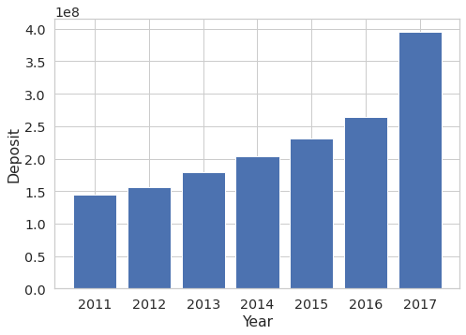
Deposit trend over years
Observations: Deposit amount increased over years

Slide 9
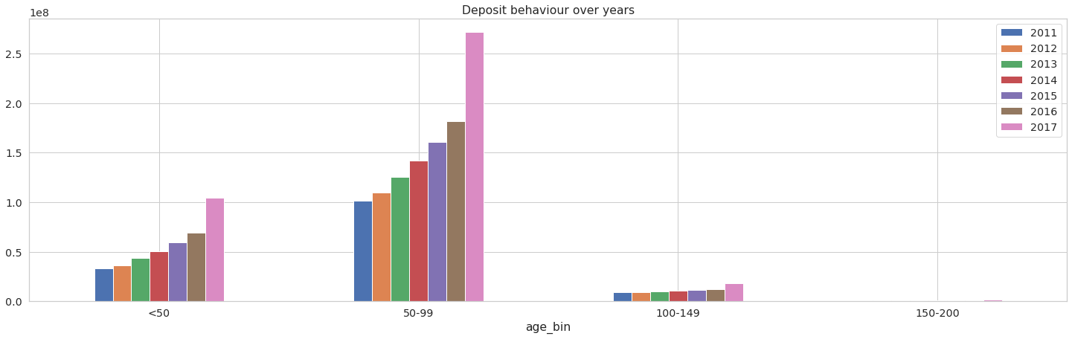
Deposit trend over years ACROSS AGE OF BANK
Observations: Most of the deposits are done in banks with age between 50 to 100

Slide 10
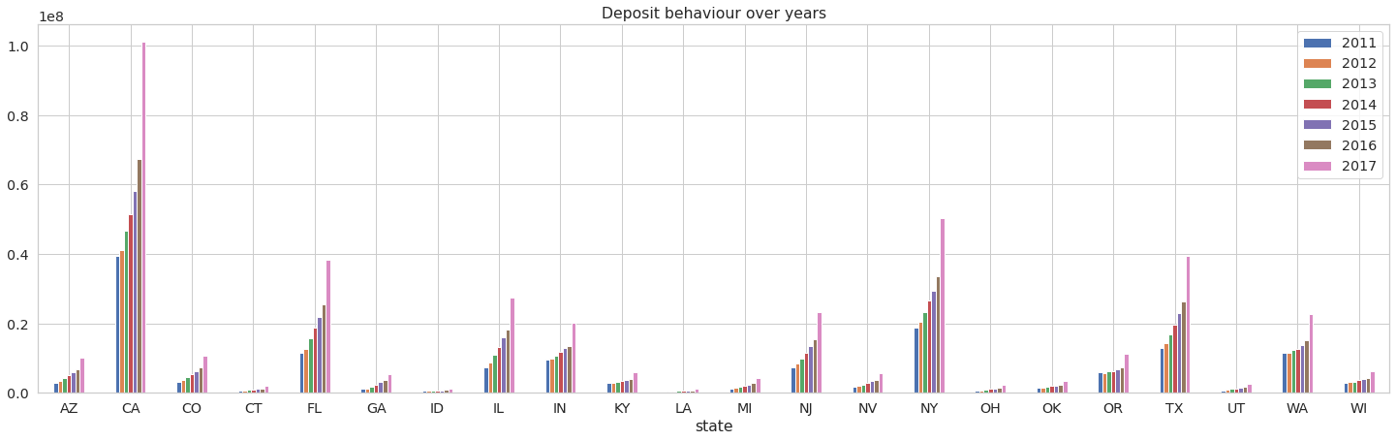
Deposit trend over years ACROSS STATES
Observations: Most of the deposits are done in states CA, FL, NY, TX, to name a few.

Slide 11





Algorithms used…
LINEAR Regression.
Random Forest.
KNN
GRADIENT BOOSTER
K-MEANS CLUSTERING

Slide 12
Some techniques used..
KNN Imputer / Simple Imputer for missing value treatment.
Isolation Forest for removing outliers.
One-Hot Encoding for categorical columns.
Standard scaling for numerical columns.
K-Means for clustering location details.
Hyper parameter tuning to improve model performance.

Slide 13
To conclude… Linear regression and Random Forest after hyper parameter tuning gave good results. Choose algorithm as per below conditions:
Linear Regression:
Computationally less expensive.
Data meets its assumptions.
Random Forest:
Computationally more expensive.
Can work on almost any kind of data.
Easy to visualize and explain.

